Slide 1
DV1C04 Operation in DevOps
L06
Operation

Slide 2
Learning Objectives
Describe Operate Phase
Describe focuses of Operate Phase
Overview of Operate Phase
Describe considerations in Operate Phase
Describe tasks in IT operation
Describe Ops In DevOps Versus Ops In Traditional
Configure puppet agent container with static IP Address

Slide 3
Goals of Operate Phase
The main goals of the Operate Phase are to ensure that deployed services are operated, monitored, and supported in line with the agreed to SLA targets:
Ensure IT services are available by improving IT staff use and better managing workload.
Ensure IT services are monitored to provide real-time observation of health conditions by mean of training team members to handle any problems efficiently and quickly.
Ensure IT services are restored quickly and effectively.
Ref: https://www.firstsolution.co.uk/blog/mof-operate-phase/#:~:text=The%20primary%20goals%20of%20the,use%20and%20better%20managing%20workload.

Slide 4
Overview of Operate Phase
Once DevOps software has gone live in production, the operations team will rely on automated tools wherever possible for configuration management, scaling and load balancing.
Ref: https://www.cloudreach.com/en/blog/6-stages-of-devops/

Slide 5
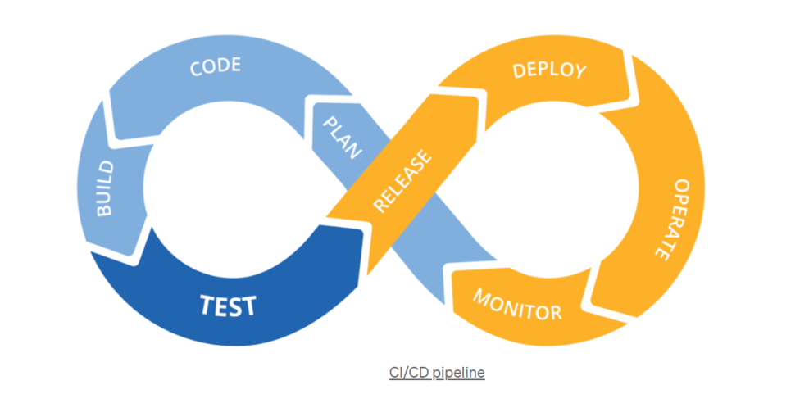
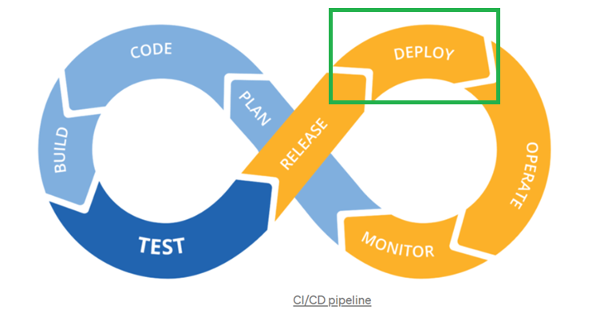
Operate Phase
Ref: https://towardsdatascience.com/ci-cd-pipeline-with-azure-devops-for-data-science-project-f263586c266e

Slide 6
Operate Phase
After DevOps software has been deployed in production, the DevOps operations team will need to use automated tools for configuration management, scaling and load balancing as much as possible. Operations provide feedback to improve code resulting in a better product. DevOps can result in better informed handoffs from one team to the other throughout the software development lifecycle (SDLC)

Slide 7
Considerations in Operate Phase
There are always ongoing challenges in operate phase. The following are some of the challenges:
Cybersecurity
New Technology​
Big Data
Ref: https://work.chron.com/challenges-information-technology-management-21st-century-28780.html

Slide 8
Considerations in Operate Phase
Cybersecurity
Data and security breaches are disastrous for any company. Real-time monitoring of all critical networks and devices can help detect problems before they get out of control.
New Technology​
There are always latest technology available for company. However, it might not be the best fit for any company. IT department must have a deep understanding of its organization's strategic goals in order to evaluate new products, services or processes effectively.
Ref: https://work.chron.com/challenges-information-technology-management-21st-century-28780.html

Slide 9
Considerations in Operate Phase
Big Data
More data than ever is being generated by businesses. Data size is growing as business expands. IT operation needs to ensure data is stored securely and redundantly. Ease of retrieving data and cost of storage are to be considered
Ref: https://work.chron.com/challenges-information-technology-management-21st-century-28780.html

Slide 10
Operation In Traditional IT
Traditionally, developers package an application and passes it to a Quality Assurance (QA) team. QA teams install and test the application before hand off to production operations teams. Once in production, operations teams are responsible for deploying and managing the application with little interaction with development teams.
Usually, the passing of application from development to operation is one-way. Once in production, the operations team is responsible for managing the service’s stability and uptime, as well as the infrastructure. If there are bugs in the application, the virtual assembly line of development to production is revisited with a patch. Many businesses continue to remain competitive with this model. However, there is faster, more collaborative way of bridging the gap between development and operations via DevOps.
Ref: https://github.blog/2020-12-03-the-evolving-role-of-operations-in-devops/

Slide 11
Operations Nowsaday
Accelerating due to public cloud adoption
Adoption of public cloud has added complexity to the responsibilities of operations teams. Cloud technologies make fast development a fundamental part of delivering a competitive customer experience:
Need to deploy applications rapidly and frequently.
Ability to rent stable, secure infrastructure by the minute and provide everything as a service to customers
Improve customer experience through rapid feedback and automated deployments
Capability of smaller, faster delivery cycles.
Ref: https://github.blog/2020-12-03-the-evolving-role-of-operations-in-devops/

Slide 12
Impacts of Fast Application Delivery
Cloud technologies have shorten the times of how we deliver and operate software.
Developers now focus more on stability and uptime in addition fast delivery
Operations teams now have a stake in fast delivery along with their traditional role of maintaining uptime.
This often means operation teams need to:
Enabling self-service for developers
Standardized tooling and processes
Bringing automation to traditional operations tasks
Working and delivering like developers
Ref: https://github.blog/2020-12-03-the-evolving-role-of-operations-in-devops/

Slide 13
Impacts of Fast Application Delivery
Enabling self-service for developers
In order to support fast delivery and minimize risks of developers seek their own solutions, operations teams work more closely with developers to provide on-demand access to secure, compliant tooling and environments.
Standardized tooling and processes.
Best way to enable sustainable efficient self-service model is by standardizing on the tooling that is in use. Tools and processes that are shared across the business unit reduces friction between developers and operations teams when sharing responsibilities.
Ref: https://github.blog/2020-12-03-the-evolving-role-of-operations-in-devops/

Slide 14
Impacts of Fast Application Delivery
Bringing automation to traditional operations tasks.
Operations teams need to a smarter way of handling traditional operations tasks like resolving incidents, updating systems, or scaling infrastructure. When development and operations unite under DevOps, operations teams need automation for more of the repeatable tasks and drive consistency.
Working and delivering like developers.
Application source code, the code controlling operations systems needs to be stored, versioned, secured, and maintained. Operations specialists become more like the developers and more familiar with their working models, and developers become more like operations, sharing in the responsibility of debugging problems with their own code in production.
Ref: https://github.blog/2020-12-03-the-evolving-role-of-operations-in-devops/

Slide 15
Closing the development-operations gap
Organizations may focus on the clearest target i.e. requesting developers and delivery teams to go to market faster while paying less attention to the post-deployment operations teams. However, best results come through improving the practices of all the teams involved in the software lifecycle. Operations teams are not just infrastructure and process owners for the organizations, but are also a critical part of the feedback loop for development.
Ref: https://github.blog/2020-12-03-the-evolving-role-of-operations-in-devops/

Slide 16
Closing the development-operations gap
Organizations may focus on the clearest target i.e. requesting developers and delivery teams to go to market faster while paying less attention to the post-deployment operations teams. However, best results come through improving the practices of all the teams involved in the software lifecycle. Operations teams are not just infrastructure and process owners for the organizations, but are also a critical part of the feedback loop for development.
Ref: https://github.blog/2020-12-03-the-evolving-role-of-operations-in-devops/

Slide 17
IT Operation
Information technology (IT) operations are IT activities that ensure an organizations' devices, IT infrastructure and technology systems are running smoothly. This generally includes support for hardware, software, and IT systems.

Slide 18
Focus of IT Operation
The focus of IT Operation is to exercise and maintain control over IT services and underlying infrastructure. This includes overseeing the associated daily and routine tasks, such as workload scheduling, creating data back-ups, restoring systems after outages and other regular maintenance activities.
Ref: https://www.sumologic.com/glossary/it-operations/

Slide 19
IT Operation Tasks
IT Operations tasks are a wide range of duties, but the followings are the most essential:
Maintenance of networking, backup, data restoration, IT security, database operations, middleware basics, load balancing, and more. IT tasks are not limited to server management, maintenance, and repair, but also any functions that support a smoothly running production environment with minimal (or no) complaints from customers and end users.
Ref: https://opensource.com/article/19/7/sysadmin-best-practices

Slide 20
IT Operations Tasks
Hardware inventory
Maintain lists of all physical and virtual servers with the following details:
OS: Linux or Windows, hypervisor with versions
RAM: DIMM slots in physical servers
CPU: Logical and virtual CPUs
HDD: Type and size of hard disks.
External storage (SAN/NAS)
Hardware appliances: e.g., Palo Alto Firewall
Ref: https://opensource.com/article/19/7/sysadmin-best-practices

Slide 21
IT Operation Tasks
Software inventory
Configured applications:
e.g., Apache Web Server, Database Server
Third-party software
Any software not shipped with the installed OS
License details
Maintain license details (inc;uding counts) for physical servers and virtual servers (VMs)
Ref: https://opensource.com/article/19/7/sysadmin-best-practices

Slide 22
IT Operation Tasks
Server health (May need to work with application team)
Running processes:
Check for processes that are consuming more resources than expected.
CPU utilization:
Monitor and check the CPU utilization of the critical process to ensure that these are not consuming the CPU resources more than expected.
Memory utilization:
Check memory utilization
Ref: https://opensource.com/article/19/7/sysadmin-best-practices

Slide 23
IT Operation Tasks
Zombie processes:
Check for zombie processes on server as these degrade server performance.
Load average:
Check the load average and tune the server for performance.
Disk/SAN/NAS utilization:
Check the I/O reports for externally attached storage to track
Ref: https://www.aquasec.com/cloud-native-academy/docker-container/container-devops/

Slide 24
IT Operation and Containers
Containers are frequently used in DevOps especially for application deployment. Hence, container management is part of IT operation.
Containerization consists of a software component and its environment etc. being placed into an isolated unit called a container. This makes it possible to deploy an application consistently on any computing environment.
Containers are easier and faster to deploy, require fewer resources to run, are easier to manage, and are generally more flexible. These helps DevOps teams segregate applications into multiple microservices, each of which can be rapidly updated and deployed. In addition, containers allow standardizing the way applications are packaged, delivered and deployed across the development lifecycle.
Ref: https://www.aquasec.com/cloud-native-academy/docker-container/container-devops/

Slide 25
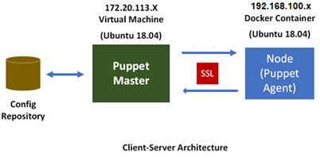
IT Operation and Containers
For this module, Puppet is used in the management of containers and their application. Puppet agents are installed into containers, which may run various microservices.

Slide 26
Prepare and create puppet-agent container
Containers are light weight. It can be pre-prepared and store as image in docker local repository or remote repository.
To prepare a puppet-agent container, the followings could be the tasks sequence:
Step 1: Create docker’s custom network
Step 2: Create a docker container
Step 3: Install commonly used packages into container
Step 4: Install puppet agent into container
Step 5: Create image using the container
Step 6: Create another container using the save image

Slide 27
Docker Custom Network
Puppet client’s IP should be static. By default, auto-assigned IP address is assigned to a docker container when it is created. However, in order for Puppet Master and Puppet Client to communicate with each other, static IP addresses are needed. Alternatively, it may be possible to use Fully Qualified Domain Name (FQDN) together with appropriate records on intranet DNS server.
In order to setup static IP addresses, need to setup docker’s custom network. The following is the command to setup a custom network.
$ docker network create –subnet=192.168.100.0/24 customnetwork

Slide 28
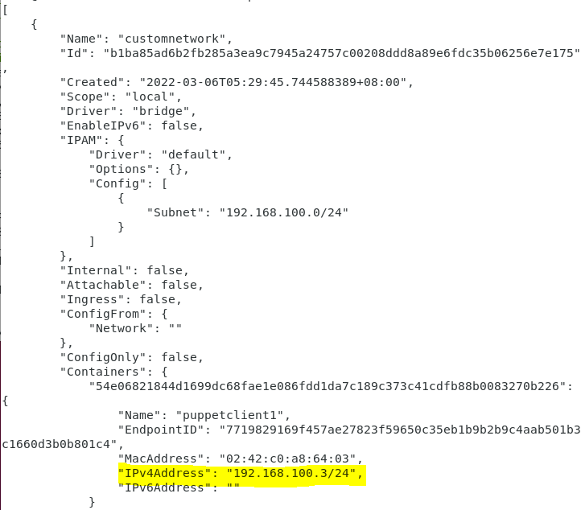
Docker Custom Network
To view the docker custom network created, issue the following command:
$ docker network inspect customnetwork

Slide 29
Common Tools in Container
There are several common tools that are used within container. The table shows the corresponding packages of several common tools.
Package Name | Purpose
curl | curl is a command-line utility for transferring data from or to a server designed to work without user interaction.
wget | GNU Wget is a command-line utility for downloading files from the web.
vim | Vim is an advanced and highly configurable text editor built to enable efficient text editing
iputils-ping | The iputils package contains basic utilities for monitoring a network, including ping.
net-tools | net-tools, the collection of base networking utilities for Linux. Commands: arp(8), hostname(1), ifconfig(8), ipmaddr, iptunnel, mii-tool(8), nameif(8), netstat(8), plipconfig(8), rarp(8), route(8) und slattach(8).
openssh-server | OpenSSH provides a server daemon and client tools to facilitate secure, encrypted remote control and file transfer operations, effectively replacing the legacy tools.

Slide 30
Install Common Tools in Container
To install the common packages within container, access a shell the container and issue the following command.
$ apt-get install curl wget vim iputils-ping net-tools openssh-server

Slide 31
Install puppet-agent in container
Within container, issue:
$ wget --content-disposition 'https://pm.puppetlabs.com/puppet-agent/2021.5.0/7.14.0/repos/deb/bionic/puppet7/puppet-agent_7.14.0-1bionic_amd64.deb'

Slide 32
Prepare image for puppet-agent container
May create a container with puppet-agent installed within. There are several commonly used packages can also be installed in the container.
Once the container with all the needed packages are installed, it can be created into a image and stored in local docker repository. The following is the syntax of docker commit command:
$docker commit [OPTIONS] CONTAINER [REPOSITORY[:TAG]]
For example:
$ docker commit <container name> <image tage>

Slide 33
Create Container with Puppet-Agent within
The following command setup a new container with static IP address:
$ docker run -d - -privileged - -net customnetwork –it –h “puppetclient1.localdomain” - -name puppetclient1 - -add-host “sddo-vm.localdomain:172.20.113.92” - -ip “192.168.100.3” puppetclient1 /sbin/bash
Where
-d : Run container in background and print container ID
--privileged : Give extended privileges to this container
--net : connect a container to a network
-h : container host name
-i : keep STDIN open
-t : Allocate a pseudo-TTY
--add-host : add a customer host-to-ip mapping (host:ip)
--name : assign a name to the container
--ip : IPv4 address (e.g., 172.30.100.104)
Notes:
For details on various options for docker run command, refer to
https://docs.docker.com/engine/reference/commandline/run/

Slide 34
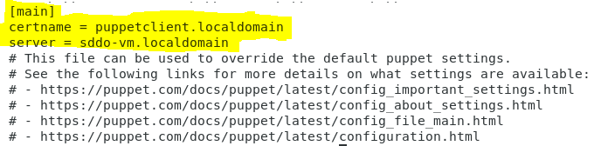
Preparing Puppet Agent Registration
Once the container is running. Add necessary entries into puppet configuration file on the container.

Slide 35
Register Puppet Agent
Finally, register the container’s puppet agent with the puppet master.
Puppet Master is now able to perform tasks on the container via puppet agent.

Slide 36
Reference
https://github.blog/2020-12-03-the-evolving-role-of-operations-in-devops
https://searchsoftwarequality.techtarget.com/answer/What-is-the-DevOps-role-for-operations-people
https://puppet.com/docs/bolt/latest/running_bolt_commands.html

Slide 37
Thank you

